Slide 1
A Tutorial on Zero-Knowledge Proofs
Basics and Implementation (Part 2)
By Olive Franzese-McLaughlin

Slide 2




Part 1: coin flipping over the phone
Did Bob really flip a coin?

Slide 3
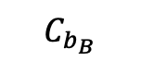
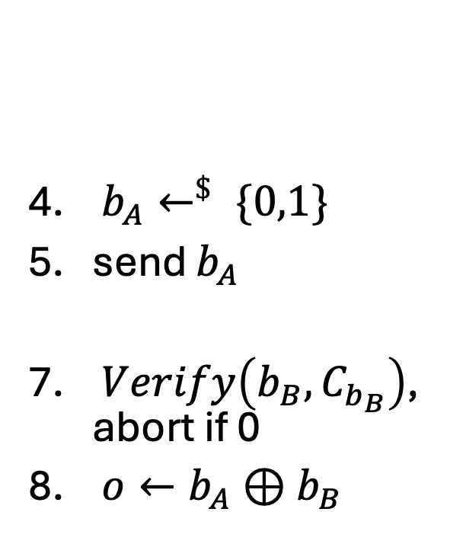
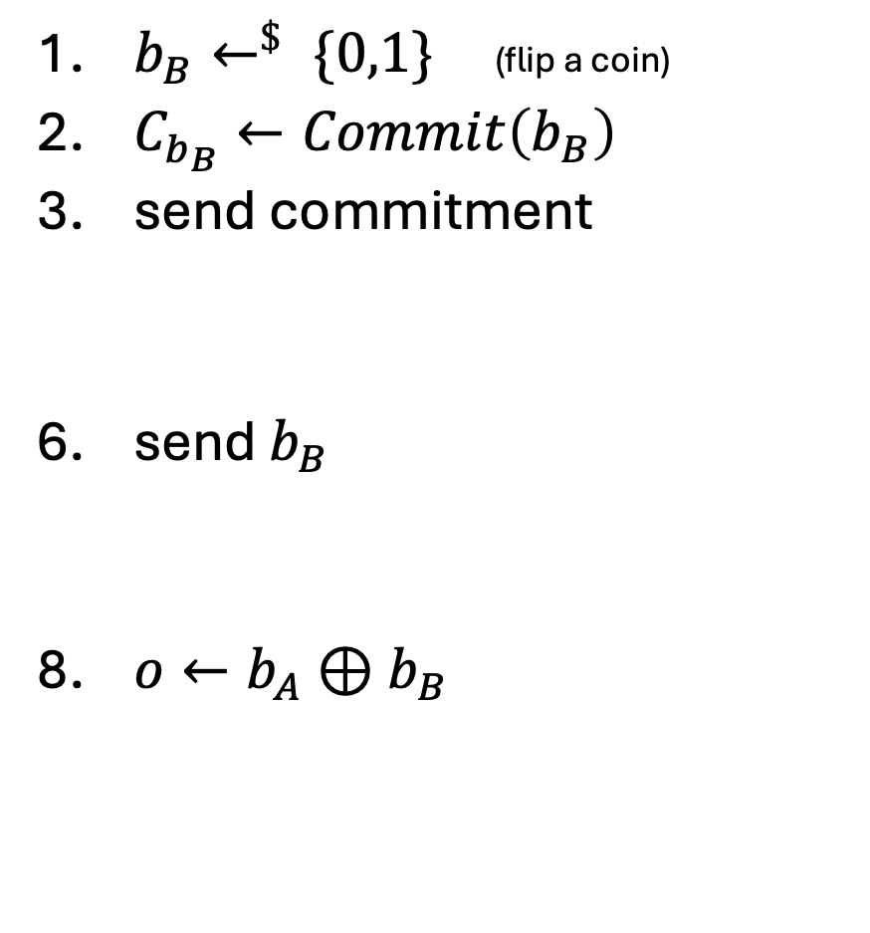
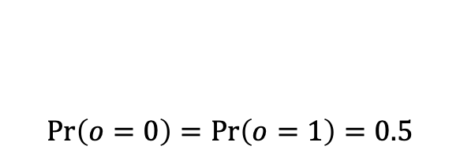
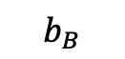
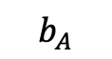
verified coin flipping using Cryptographic Commitments
$b_{B}←^{\$} \{0,1\}$ (flip a coin)
$C_{b_{B}}←Commit\left(b_{B}\right)$
send commitment
send $b_{B}$
$o←b_{A}⊕b_{B}$
$b_{A}←^{\$} \{0,1\}$
send $b_{A}$
$Verify\left(b_{B}, C_{b_{B}}\right)$, abort if 0
$o←b_{A}⊕b_{B}$
$$C_{b_{B}}$$
$$b_{A}$$
$$b_{B}$$
$$\operatorname{Pr}\left(o=0\right)=\operatorname{Pr}\left(o=1\right)=0.5$$
“Soundness”
Even if Alice OR Bob tries to disrupt the outcome

Slide 4

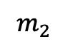

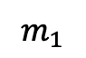
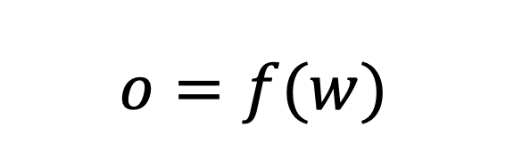
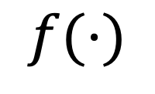
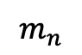
Part 2: Goal - verify computation of any* function over the phone
*
$$f(⋅)$$
Input: $w$
$$m_{1}$$
$$m_{2}$$
$$…$$
$$m_{n}$$
$$o=f(w)$$
Goal (1):
Soundness – no matter what Bob does, he cannot convince Alice to accept $o≠f\left(w\right)$
(i.e. he will always be caught if he causes an incorrect output, given fixed input w)
*(computable)

Slide 5

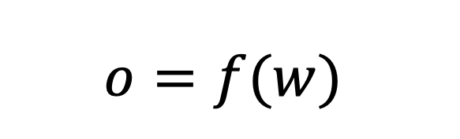
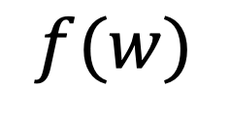

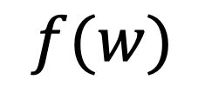
Easy Solution (When Input Can Be Shared)
Input: $w$
$$w$$
$$f(w)$$
$$f(w)$$
$$o=f(w)$$
Cryptographic Commitments
will help us again
What about if w is sensitive information?
verify possession of a password w/o revealing it
verify age/location to someone you don’t trust
verify properties of an ML model w/o revealing data or parameters
Goal (2):
Zero-Knowledge – no matter what Alice does, she cannot learn (additional) info about w
(beyond what is revealed implicitly by f(w))

Slide 6
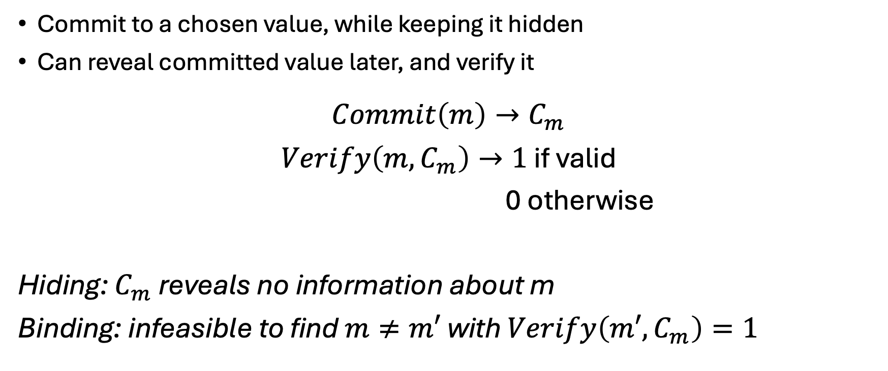
recall: Cryptographic Commitments
Commit to a chosen value, while keeping it hidden
Can reveal committed value later, and verify it
$$Commit\left(m\right)→C_{m}$$
$Verify\left(m, C_{m}\right)→1$ if valid
0 otherwise
Hiding: $C_{m}$ reveals no information about m
Binding: infeasible to find $m≠m′$ with $Verify\left(m′, C_{m}\right)=1$

Slide 7
How do Commitments help with verification?
$$f(⋅)$$
Input: $w$
$$m_{1}$$
$$m_{2}$$
$$…$$
$$m_{n}$$
$$o=f(w)$$

Slide 8

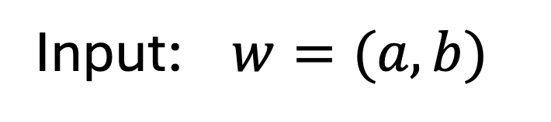
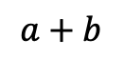
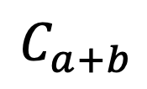
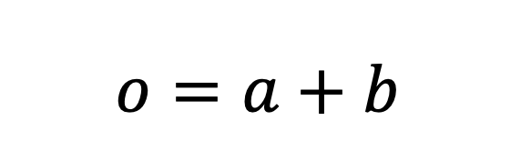
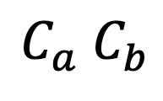
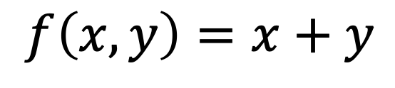
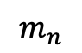
start simpler: verified sum of hidden values
$$f\left(x,y\right)=x+y$$
Input: $w=(a, b)$
$$Commit\left(a\right)→C_{a}$$
$$C_{a} C_{b}$$
$$Commit\left(b\right)→C_{b}$$
$$m_{1}$$
$$m_{2}$$
$$…$$
$$m_{n}$$
Goal:
(Will be convenient when we build on it later)
$$C_{a+b}$$
“open”
$$a+b$$
$$o=a+b$$
$$Verify(a+b, C_{a+b})$$

Slide 9
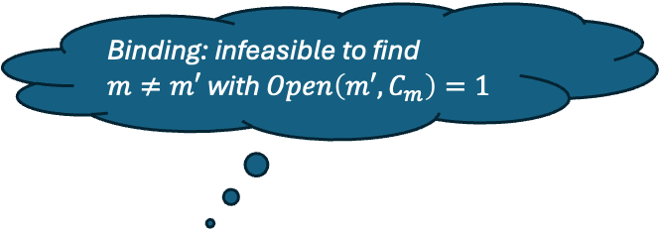
start simpler: verified sum of hidden values
$$f\left(x,y\right)=x+y$$
Input: $w=(a, b)$
$$Commit\left(a\right)→C_{a}$$
$$C_{a} C_{b}$$
$$Commit\left(b\right)→C_{b}$$
$$m_{1}$$
$$m_{2}$$
$$…$$
$$m_{n}$$
Goal:
Binding: infeasible to find
$m≠m′$ with $Open\left(m′, C_{m}\right)=1$
$$C_{a+b}$$
“open”
$$a+b$$
Soundness
$$o=a+b$$
$$Verify(a+b, C_{a+b})$$
Zero-Knowledge

Slide 10

start simpler: verified sum of hidden values
$$f\left(x,y\right)=x+y$$
Input: $w=(a, b)$
$$Commit\left(a\right)→C_{a}$$
$$C_{a} C_{b}$$
$$Commit\left(b\right)→C_{b}$$
$$m_{1}$$
$$m_{2}$$
$$…$$
$$m_{n}$$
Goal:
Binding: infeasible to find
$m≠m′$ with $Open\left(m′, C_{m}\right)=1$
(Will be convenient when we build on it later)
$$C_{a+b}$$
“open”
$$a+b$$
Soundness
$$o=a+b$$
$$Verify(a+b, C_{a+b})$$
Hiding: $C_{m}$ reveals no information about m
Zero-Knowledge

Slide 11

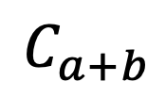


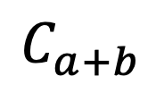
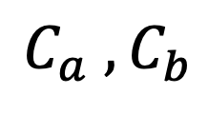
Attempt 1
(need another tool to make this work, but let’s play with it and see where we get stuck)
Input: $(a, b)$
$$C_{a} ,C_{b}$$
$$Commit\left(a\right)→C_{a}$$
$$Commit\left(b\right)→C_{b}$$
$$Commit\left(a+b\right)→C_{a+b}$$
$$C_{a+b}$$
no matter what Alice does, she cannot learn (additional) info about w
Goal:
Hiding: $C_{m}$ reveals no information about m
$$C_{a+b}$$
Zero-Knowledge

Slide 12

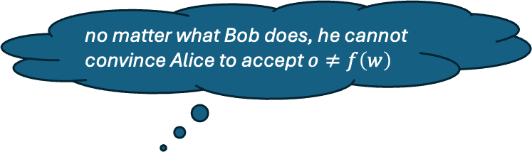
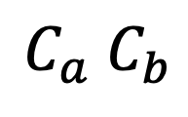
Attempt 1
(need another tool to make this work, but let’s play with it and see where we get stuck)
Input: $(a, b)$
$$C_{a} C_{b}$$
$$Commit\left(a\right)→C_{a}$$
$$Commit\left(b\right)→C_{b}$$
$$Commit\left(a+b\right)→C_{a+b}$$
$$C_{a+b}$$
no matter what Bob does, he cannot convince Alice to accept $o≠f\left(w\right)$
Goal:
Soundness
$$C_{a+b}$$
Zero-Knowledge

Slide 13
Attempt 1
(need another tool to make this work, but let’s play with it and see where we get stuck)
Input: $(a, b)$
$$C_{a} C_{b}$$
$$Commit\left(a\right)→C_{a}$$
$$Commit\left(b\right)→C_{b}$$
$$Commit\left(a+b\right)→C_{a+b}$$
$$C_{a+b}$$
$$Commit\left(a′+b′\right)→C_{a′+b′}$$
Goal:
Soundness
$$C_{a+b}$$
Zero-Knowledge

Slide 14
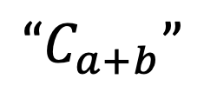
Attempt 1
(need another tool to make this work, but let’s play with it and see where we get stuck)
Input: $(a, b)$
$$C_{a} C_{b}$$
$$Commit\left(a\right)→C_{a}$$
$$Commit\left(b\right)→C_{b}$$
$$Commit\left(a+b\right)→C_{a+b}$$
$$“C_{a+b}”$$
$$Commit\left(a′+b′\right)→C_{a′+b′}$$
Goal:
Soundness
$$C_{a+b}$$
Zero-Knowledge

Slide 15
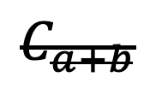
Attempt 1
(need another tool to make this work, but let’s play with it and see where we get stuck)
Input: $(a, b)$
$$C_{a} C_{b}$$
$$Commit\left(a\right)→C_{a}$$
$$Commit\left(b\right)→C_{b}$$
$$Commit\left(a+b\right)→C_{a+b}$$
$$“C_{a+b}”$$
$$Commit\left(a′+b′\right)→C_{a′+b′}$$
Goal:
Soundness
$$C_{a+b}$$
Zero-Knowledge

Slide 16
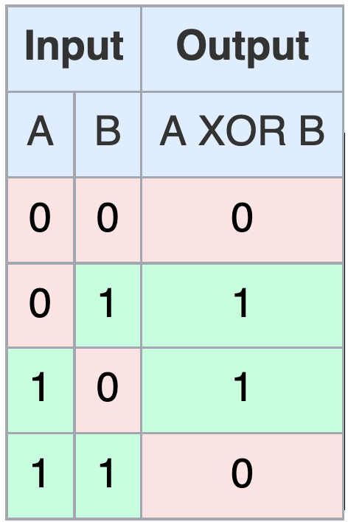
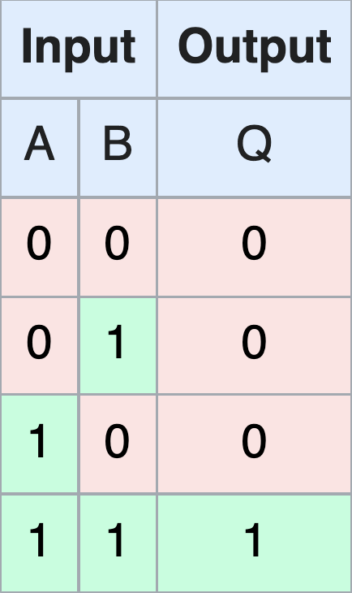

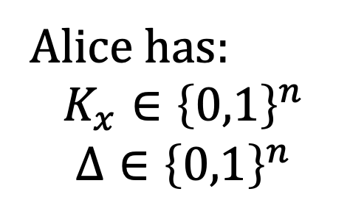
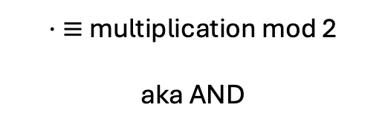
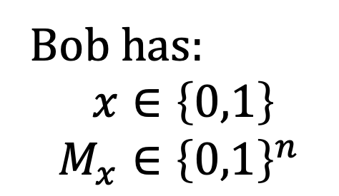
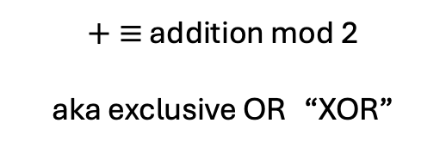

IT-MAC based commitments
Bob has:
$x∈\left\{0,1\right\}$
$$M_{x}∈{\left\{0,1\right\}}^{n}$$
Alice has:
$$K_{x}∈{\left\{0,1\right\}}^{n}$$
$$Δ∈{\left\{0,1\right\}}^{n}$$
$+ ≡$ addition mod 2
aka exclusive OR “XOR”
Such that
$⋅ ≡$ multiplication mod 2
aka AND
$$M_{x}=K_{x}+Δ⋅x$$

Slide 17
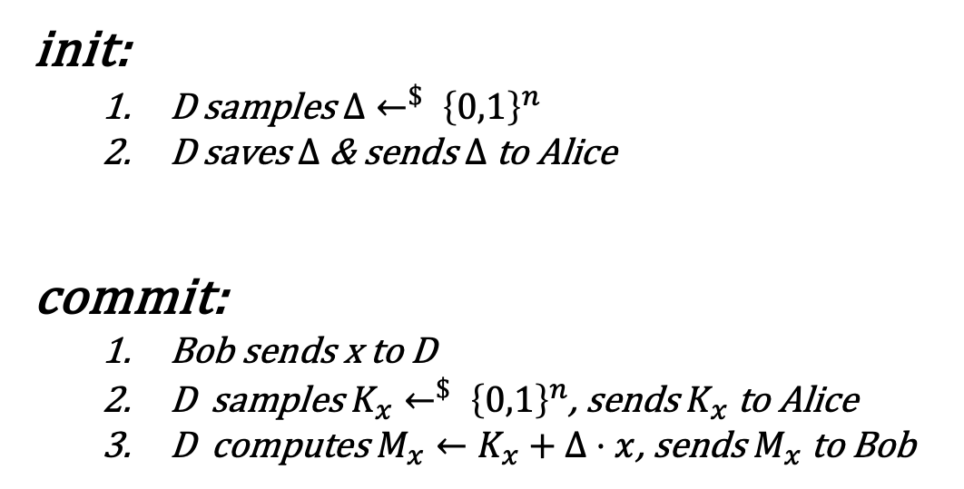

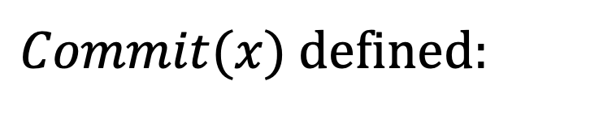

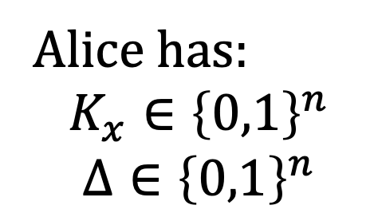

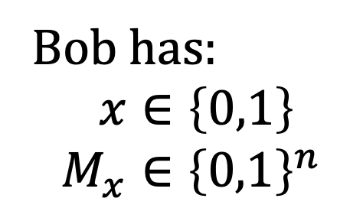
IT-MAC based commitments
$Commit(x)$ defined:
Bob has:
$x∈\left\{0,1\right\}$
$$M_{x}∈{\left\{0,1\right\}}^{n}$$
Assume a trusted Dealer D
not required in practice, easiest to explain this way for now
init:
D samples $Δ←^{\$} {\left\{0,1\right\}}^{n}$
D saves $Δ$ & sends $Δ$ to Alice
commit:
Bob sends x to D
D samples $K_{x}←^{\$} {\left\{0,1\right\}}^{n}$, sends $K_{x}$ to Alice
D computes $M_{x}←K_{x}+Δ⋅x$, sends $M_{x}$ to Bob
Alice has:
$$K_{x}∈{\left\{0,1\right\}}^{n}$$
$$Δ∈{\left\{0,1\right\}}^{n}$$
Hiding?
$“C_{m}$ reveals no information about m”

Slide 18
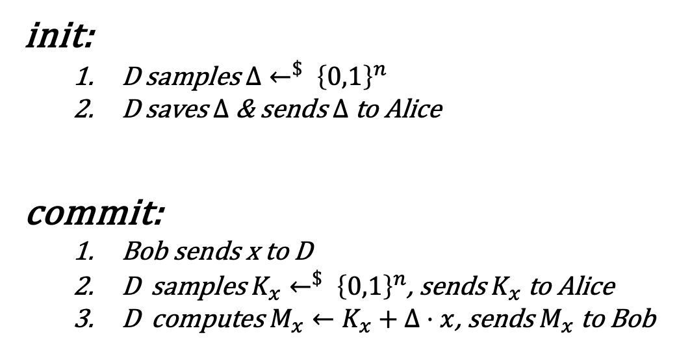
IT-MAC based commitments
$Commit(x)$ defined:
Bob has:
$x∈\left\{0,1\right\}$
$$M_{x}∈{\left\{0,1\right\}}^{n}$$
Assume a trusted Dealer D
not required in practice, easiest to explain this way for now
init:
D samples $Δ←^{\$} {\left\{0,1\right\}}^{n}$
D saves $Δ$ & sends $Δ$ to Alice
commit:
Bob sends x to D
D samples $K_{x}←^{\$} {\left\{0,1\right\}}^{n}$, sends $K_{x}$ to Alice
D computes $M_{x}←K_{x}+Δ⋅x$, sends $M_{x}$ to Bob
Alice has:
$$K_{x}∈{\left\{0,1\right\}}^{n}$$
$$Δ∈{\left\{0,1\right\}}^{n}$$
Hiding

Slide 19
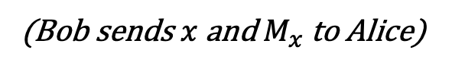
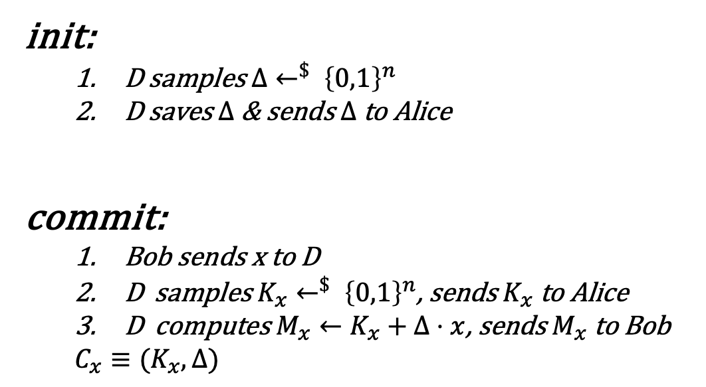


IT-MAC based commitments
$Commit(x)$ defined:
$Verify(x,M_{x},C_{x})$defined:
Assume a trusted Dealer D
not required in practice, easiest to explain this way for now
(Bob sends $x$ and $M_{x}$ to Alice)
init:
D samples $Δ←^{\$} {\left\{0,1\right\}}^{n}$
D saves $Δ$ & sends $Δ$ to Alice
commit:
Bob sends x to D
D samples $K_{x}←^{\$} {\left\{0,1\right\}}^{n}$, sends $K_{x}$ to Alice
D computes $M_{x}←K_{x}+Δ⋅x$, sends $M_{x}$ to Bob
$C_{x}≡(K_{x}, Δ)$
Alice checks:
$$M_{x} \text{≟} K_{x}+Δ⋅x$$
output:
1 if equality holds
0 o/w
“infeasible for Bob to find $x′≠x$ with Verify$\left(x′, C_{x}\right)=1$”
Hiding
Binding?

Slide 20


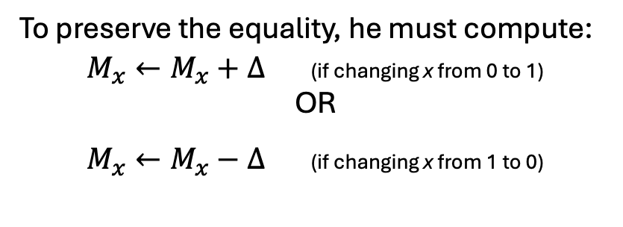
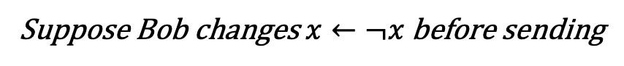

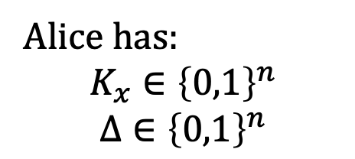
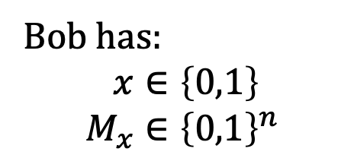
IT-MAC based commitments
$Verify(x,M_{x},C_{x})$defined:
Bob has:
$x∈\left\{0,1\right\}$
$$M_{x}∈{\left\{0,1\right\}}^{n}$$
Alice has:
$$K_{x}∈{\left\{0,1\right\}}^{n}$$
$$Δ∈{\left\{0,1\right\}}^{n}$$
(Bob sends $x$ and $M_{x}$ to Alice)
Alice checks:
Suppose Bob changes $x←¬x$ before sending
$$M_{x} \text{≟} K_{x}+Δ⋅x$$
Then he must change $M_{x}$, or check fails
output:
1 if equality holds
0 o/w
To preserve the equality, he must compute:
$M_{x}←M_{x}+Δ$ (if changing x from 0 to 1)
OR
$M_{x}←M_{x}−Δ$ (if changing x from 1 to 0)
“infeasible for Bob to find $x′≠x$ with $Verify\left(x′, C_{x}\right)=1$”
But Bob does not know $Δ$ and it is a random string
$⇒2^{n}$chance of guessing
Binding?

Slide 21
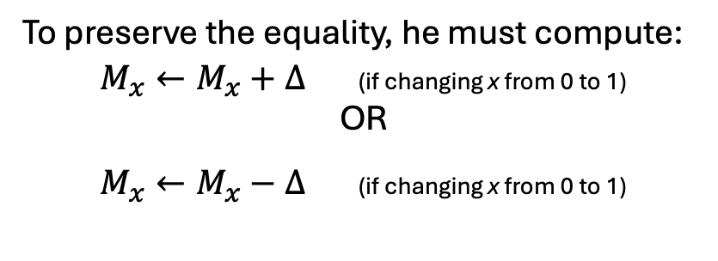

IT-MAC based commitments
$Verify(x,M_{x},C_{x})$defined:
Bob has:
$x∈\left\{0,1\right\}$
$$M_{x}∈{\left\{0,1\right\}}^{n}$$
Alice has:
$$K_{x}∈{\left\{0,1\right\}}^{n}$$
$$Δ∈{\left\{0,1\right\}}^{n}$$
(Bob sends $x$ and $M_{x}$ to Alice)
Alice checks:
Suppose Bob changes $x←¬x$ before sending
$$M_{x} \text{≟} K_{x}+Δ⋅x$$
Then he must change $M_{x}$, or check fails
output:
1 if equality holds
0 o/w
To preserve the equality, he must compute:
$M_{x}←M_{x}+Δ$ (if changing x from 0 to 1)
OR
$M_{x}←M_{x}−Δ$ (if changing x from 0 to 1)
“infeasible for Bob to find $x′≠x$ with $Verify\left(x′, C_{x}\right)=1$”
But Bob does not know $Δ$ and it is a random string
$⇒2^{n}$chance of guessing
Binding

Slide 22
IT-MAC based commitments
$Commit(x)$ defined:
$Verify(x,M_{x},C_{x})$defined:
Assume a trusted Dealer D
not required in practice, easiest to explain this way for now
(Bob sends $x$ and $M_{x}$ to Alice)
init:
D samples $Δ←^{\$} {\left\{0,1\right\}}^{n}$
D saves $Δ$ & sends $Δ$ to Alice
commit:
Bob sends x to D
D samples $K_{x}←^{\$} {\left\{0,1\right\}}^{n}$, sends $K_{x}$ to Alice
D computes $M_{x}←K_{x}+Δ⋅x$, sends $M_{x}$ to Bob
Alice checks:
$$M_{x} \text{≟} K_{x}+Δ⋅x$$
output:
1 if equality holds
0 o/w
Hiding
Binding

Slide 23



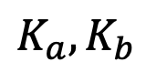
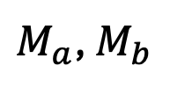

verified sum w/ IT-MAC commitments
D
Input: $(a, b)$
$$Δ$$
$$Commit\left(a\right)$$
$$Commit\left(b\right)$$
such that
(1) $M_{a}=K_{a}+Δ⋅a$
$M_{a}$, $M_{b}$
$$K_{a}, K_{b}$$
(2) $M_{b}=K_{b}+Δ⋅b$
Goal:
$$C_{a+b}$$

Slide 24





verified sum w/ IT-MAC commitments
D
Input: $(a, b)$
$$Δ$$
$$Commit\left(a\right)$$
$$Commit\left(b\right)$$
such that
(1) $M_{a}=K_{a}+Δ⋅a$
$M_{a}$, $M_{b}$
$$K_{a}, K_{b}$$
(2) $M_{b}=K_{b}+Δ⋅b$
Goal:
such that
$$M_{a+b}$$
$$M_{a+b}=K_{a+b}+Δ⋅(a+b)$$
$$K_{a+b}$$
$M_{a}+M_{b}=K_{a}+Δ⋅a+K_{b}+Δ⋅b$ add (1) and (2)
${(M}_{a}+M_{b})={(K}_{a}+K_{b})+Δ⋅(a+b)$ rearrange
IT-MAC commitments are “additively homomorphic”
If you add two commitments together, you get a commitment to the sum!

Slide 25






verified sum protocol
D
Input: $(a, b)$
$$Δ$$
$$Commit\left(a\right)$$
$$Commit\left(b\right)$$
such that
(1) $M_{a}=K_{a}+Δ⋅a$
$M_{a}$, $M_{b}$
$$K_{a}, K_{b}$$
(2) $M_{b}=K_{b}+Δ⋅b$
compute
$$a+b$$
$$M_{a+b}←M_{a}+M_{b}$$
compute
$$K_{a+b}←K_{a}+K_{b}$$
Same as argument that IT-MAC is binding
$$a+b, { M}_{a+b}$$
$$Verify(a+b, C_{a+b})$$
Soundness
Commitments are hiding
$$o=a+b$$
$$M_{a+b} \text{≟} K_{a+b}+Δ⋅(a+b)$$
Zero-Knowledge

Slide 26

Roadmap
Verifying Hidden Computations
what is a zero-knowledge proof and how does it work?
Part 1:
commitments (definition)
verified coin flipping
Part 2:
commitments (example: IT-MAC)
verified addition of two hidden numbers
[…]
verified computation of any function on hidden inputs
AKA zero-knowledge proofs

Slide 27
Roadmap
Verifying Hidden Computations
what is a zero-knowledge proof and how does it work?
Part 1:
commitments (definition)
verified coin flipping
Part 2:
commitments (example: IT-MAC)
verified addition of two hidden numbers
[…]
verified computation of any function on hidden inputs
AKA zero-knowledge proofs
verified multiplication of two hidden numbers
that’s all we need (!)
(definition)

Slide 28








verified sum protocol
verified product protocol
Inputs: $(a, b)$
$(C_{a, }C_{b})$
Inputs: $(a, b)$
$(C_{a, }C_{b})$
(explained in prev slides)
(extra slides)
Outputs: $a+b$
$$C_{a+b}$$
Outputs: $a⋅b$
$$C_{a⋅b}$$

Slide 29













Get other verified operations ‘for free’ by composing sum and product
verify: ($a+b)⋅c$
$Commit\left(a\right)$, $Commit\left(b\right)$, $Commit\left(c\right)$
$$(a, b)$$
$(C_{a, }C_{b})$
$C_{a}$, $C_{b}, C_{c}$
+
$$a+b$$
$$C_{a+b}$$
what functions can we verify this way?
$$(a+b, c)$$
$$(C_{a+b, }C_{c})$$
*
all computable functions (!)
$$\left(a+b\right)⋅c$$
$$C_{\left(a+b\right)⋅c}$$
“open”
$$\left(a+b\right)⋅c$$
$$Verify((a+b)⋅c, C_{(a+b)⋅c})$$

Slide 30






verify any computable function by composing sum and product
{AND, XOR, TRUE} is functionally complete
+
*
any Boolean function can be derived from a Circuit composed of these operators
$$∀f(⋅)$$
$${∃f}_{Circuit}(⋅)$$
$+ ≡$ addition mod 2
aka exclusive OR “XOR”
$⋅ ≡$ multiplication mod 2
aka AND
$$b_{1}$$
$$b_{2}$$
$$b_{3}$$
$$…$$
$$b_{n}$$
+
+
*
$$o_{1}$$
*
$${\begin{aligned}∀x∈{\left\{0,1\right\}}^{n} \\ f(x)=f_{Circuit}(x)\end{aligned}}_{ }$$

Slide 31











General Zero-Knowledge Proofs via Verified Circuit Evaluation
$$f(⋅)$$
(compiler)
$$f_{Circuit}(⋅)$$
Input: $w=(b_{1}, b_{2},…b_{n})$
Prover
$$Commit(w)$$
$$C_{b_{1}},C_{b_{2}}, …C_{b_{n}}$$
Verifier
$${∀gates G∈f}_{Circuit}(⋅)$$
evaluate verified (if G is an XOR gate)
or (if G is an AND gate)
(w/ appropriate inputs)
+
*
Output bits: $o_{1}, o_{2},…, o_{m}$
$$C_{o_{1}},C_{o_{2}}, …C_{o_{m}}$$
${∀o}_{i},$ open $o_{i}$
$$o_{i}$$
$$Verify(o_{i}, C_{o_{i}})$$

Slide 32


https://eprint.iacr.org/2020/925.pdf
https://github.com/emp-toolkit/emp-zk

Slide 33



https://github.com/olea-digitalis/emp-zk-tutorial tutorial repo
test/basic_zk.cpp
To compile:
cmake . && make
To run:
./run bin/test_basic_zk

Slide 34



Slide 35



Slide 36




Slide 37



Slide 38

Control Flow

Slide 39





Slide 40

test/exercises_zk.cpp

Slide 41


Slide 42



Slide 43





Slide 44




homework exercises in test/homework_zk.cpp

Slide 45
end

Slide 46




verified product protocol
Want:
Inputs: $(a, b)$
$(C_{a, }C_{b})$
?
Outputs: $a⋅b$
$$C_{a⋅b}$$
Intermediate steps: verified + and * by a public value x

Slide 47






verified multiplication by public value x (definition)
D
Input: $a$
$$Δ$$
$$Commit\left(a\right)$$
such that
(1) $M_{a}=K_{a}+Δ⋅a$
$$M_{a}$$
$$K_{a}$$
compute
$$a⋅x$$
$$M_{a⋅x}←M_{a}⋅c$$
compute
$$K_{a⋅x}←K_{a}⋅c$$
such that
$M_{a⋅x}=K_{a⋅x}+Δ⋅(a⋅x)$

Slide 48






verified multiplication by public value x
D
Input: $a$
$$Δ$$
$$Commit\left(a\right)$$
such that
(1) $M_{a}=K_{a}+Δ⋅a$
$$M_{a}$$
$$K_{a}$$
compute
$$a⋅x$$
$$M_{a⋅x}←M_{a}⋅x$$
compute
$$K_{a⋅x}←K_{a}⋅x$$
since
$${x⋅M}_{a}=x{⋅(K}_{a}+Δ⋅a)$$
$${(x⋅M}_{a})=(x{⋅K}_{a})+Δ⋅(a⋅x)$$

Slide 49




verified addition by public value x (definition)
D
Input: $a$
$$Δ$$
$$Commit\left(a\right)$$
such that
(1) $M_{a}=K_{a}+Δ⋅a$
$$M_{a}$$
$$K_{a}$$
compute
$$a+x$$
$$M_{a+x}←M_{a}⋅c$$
compute
$$K_{a+x}←K_{a}⋅c$$
such that
$M_{a+x}=K_{a+x}+Δ⋅(a+x)$
$M_{a}=K_{a}+Δa+Δx−Δx$
$$M_{a}={(K}_{a}−Δx)+Δ(a+x)$$
add a clever 0 to (1)

Slide 50


verified addition by public value x
D
Input: $a$
$$Δ$$
$$Commit\left(a\right)$$
such that
(1) $M_{a}=K_{a}+Δ⋅a$
$$M_{a}$$
$$K_{a}$$
compute
$$a+x$$
$$M_{a+x}←M_{a}$$
compute
$$K_{a+x}←K_{a}−Δx$$
such that
$M_{a+x}=K_{a+x}+Δ⋅(a+x)$
$M_{a}=K_{a}+Δa+Δx−Δx$
$$M_{a}={(K}_{a}−Δx)+Δ(a+x)$$

Slide 51










verified multiplication for two hidden values
Using multiplication triples
Inputs: $(a, b)$
$(C_{a, }C_{b})$
Inputs: $(u, v,w)$
Such that:
$$u,v←^{\$}\{0,1\}$$
$$u⋅v=w$$
$$(C_{u}, C_{v},C_{w})$$
$δ_{a}←$ Open $\left(a−u\right)$
$δ_{b}←$ Open $\left(b−v\right)$
(preserves Zero-Knowledge since $\left(a−u\right)$ and $\left(b−v\right)$ are uniform random bits)
Claim:
$$δ_{a}δ_{b}+vδ_{a}+uδ_{b}+w=a⋅b$$
$$\left(a−u\right)\left(b−v\right)+v\left(a−u\right)+u\left(b−v\right)+uv$$
$$=ab−av−ub+uv+va−vu+ub−uv+uv$$
$$=ab.$$
using homomorphic addition & multiplication
compute
$$δ_{a}δ_{b}+vδ_{a}+uδ_{b}+w$$
compute
$$δ_{a}δ_{b}+C_{v}δ_{a}+C_{u}δ_{b}+C_{w}$$
Outputs: $a⋅b$
$$C_{a⋅b}$$

